Slide 1
Project Management Introduction (H17D 34)
HNC Computing

Slide 2
Course Outline
Project Definition √
Project Management Triangle √
Work Breakdown Structure (WBS) √
Project Management Methodologies
Project Stakeholders
Project Roles & Responsibilities
Brainstorming & Team Work
Project Planning, Scoping & Monitoring
Project Costing & Budgeting
Critical Path Analysis
Project Management Tools – MS Project, Gantt chart…
Class Exercises – Project Management Tasks

Slide 3
Part A: Project Management Introduction (Project Definition, PM Triangle, WBS, KPIs)
Notes:
Q. Which of the WBS stage will you consider as the most important and least important during project management, and why? Explain your answers

Slide 4
Project & Project Management Definition
What is a Project?
A project may be defined as a unique set of coordinated activities with precise starting and finishing dates undertaken by an individual or group of individuals (i.e. team) to meet specific objectives within specified time, cost and performance parameters.
What is Project Management?
This is defined as the planning, monitoring, and control of all aspects of a project , with the aim/motivation of the individual or team involved to achieve the specified objectives/goals for the project on time, specified cost/budget, quality & standards and performance.

Slide 5
Characteristics of a Project
The main characteristics of a project can be summarised below;
Non-routine
Unique
An instrument of change
Temporary – i.e. with start and finish dates
Consist of interdependent activities
Intended to achieve specific outcomes or goals/objectives
Usually involve some degree of risks or uncertainty
Usually involves different people working together

Slide 6
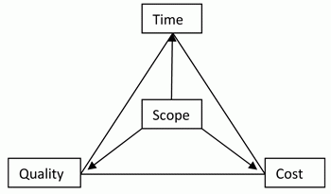
Project Management Triangle

Slide 7
Project Management Triangle – Contd.
Time
A project's activities can either take shorter or longer amount of time to complete. Completion of tasks depends on a number of factors such as the number of people working on the project, experience, skills, etc.
Time is a crucial factor which is uncontrollable. On the other hand, failure to meet the deadlines in a project can create adverse effects. Most often, the main reason for organizations to fail in terms of time is due to lack of resources. Project
Cost
It's imperative for both the project manager and the organization to have an estimated cost when undertaking a project. Budgets will ensure that project is developed or implemented below a certain cost.
Sometimes, project managers have to allocate additional resources in order to meet the deadlines with a penalty of additional project costs.

Slide 8
Project Management Triangle – Contd.
Scope
Scope looks at the outcome of the project undertaken. This consists of a list of deliverables, which need to be addressed by the project team.
A successful project manager will know to manage both the scope of the project and any change in scope which impacts time and cost.
Quality
Quality is not a part of the project management triangle, but it is the ultimate objective of every delivery. Hence, the project management triangle represents implies quality.
Many project managers are under the notion that 'high quality comes with high cost', which to some extent is true. By using low quality resources to accomplish project deadlines does not ensure success of the overall project.
Like with the scope, quality will also be an important deliverable for the project.

Slide 9
Project Management – KPI Ranking
* KPI – (Key Performance Indicators)
Project cost
Deadline/Time
Personnel
HSE
Risks management
Equipment
Materials
Weather
Logistics
Politics
Specification/Standard Regulations
Technological Advancement

Slide 10
Work Breakdown Structure (WBS)
WBS has been developed over the years as an excellent tool for quantifying the scope of work as a list of work packages
It is an essential tool for ensuring that the estimate or quotation for executing a project includes the complete scope of work.
The purpose of WBS is to breakdown or subdivide the scope of work into a number of manageable work packages that are easier to estimate, plan and assign to a responsible person or department for completion.
Notes:
Q. Which of the WBS stage will you consider as the most important and least important during project management, and why? Explain your answers

Slide 11
Work Breakdown Structure (WBS)
Project Definition
Planning stage
Development stage
Analysis stage
Test stage
Evaluation stage
Implementation stage
Handover
Notes:
Q. Which of the WBS stage will you consider as the most important and least important during project management, and why? Explain your answers

Slide 12
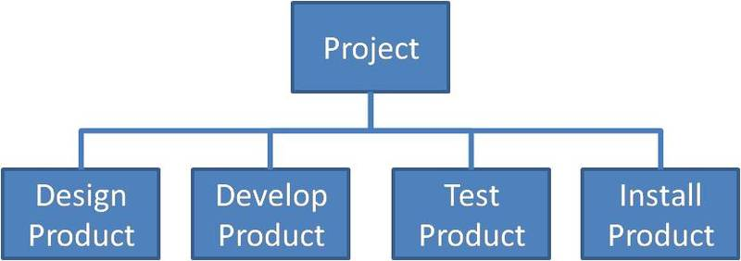
Work Breakdown Structure (WBS) – Flow Charts
# WBS Example for Product Design – High Level
Notes:
Q. Which of the WBS stage will you consider as the most important and least important during project management, and why? Explain your answers

Slide 13
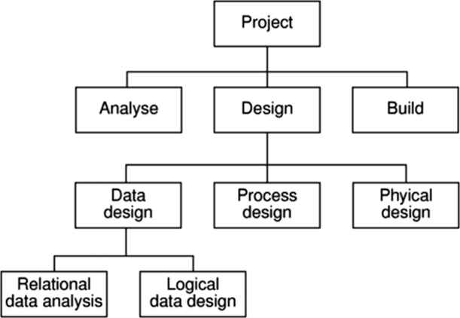
Work Breakdown Structure (WBS) – Flow Charts
# WBS Example for a Database Design Project
Notes:
Q. Which of the WBS stage will you consider as the most important and least important during project management, and why? Explain your answers

